Slide 1
Customer Segmentation
Analysis
Alev Yildirim
Ironhack Final Project

Slide 2
Customer Segmentation
Customer Profile
The Data
1
8
Creating client portfolios for better marketing strategies
8
2
The data consists of 3900 subscribers in our Amazon store.
1
7
Defining client clusters by age groups and purchasing habits
Subscription, Promo Code use, Discount apply
2
7
3
6
Client Clustering Models
Online payment methods
3
6
4
5
Correlation between review ratings and buying habits
5
Frequency of purchases, previous purchases
4

Slide 3
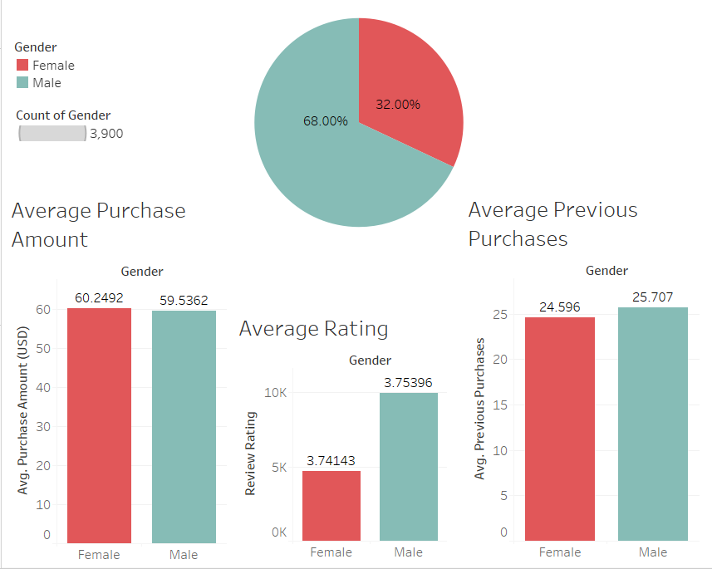
Subscriber Portfolio
3,900
Subscribed Users

Slide 4
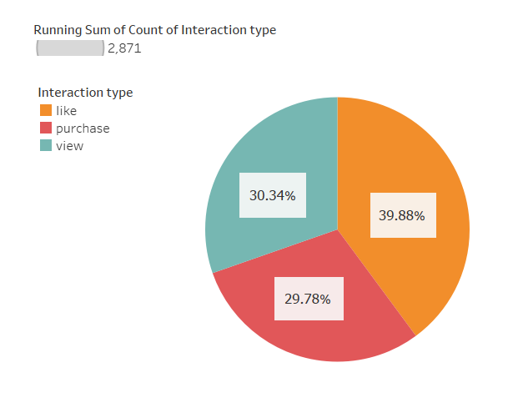
Customer Interaction
Interaction of subscribed clients
Liked the product
39,9%
Viewed the product
30,3%
Purchased the product
29,8%

Slide 5
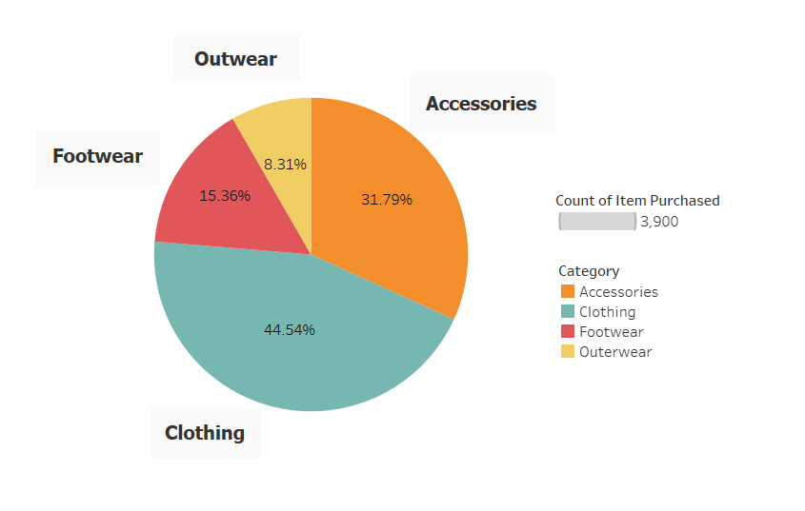
Product Info

Slide 6
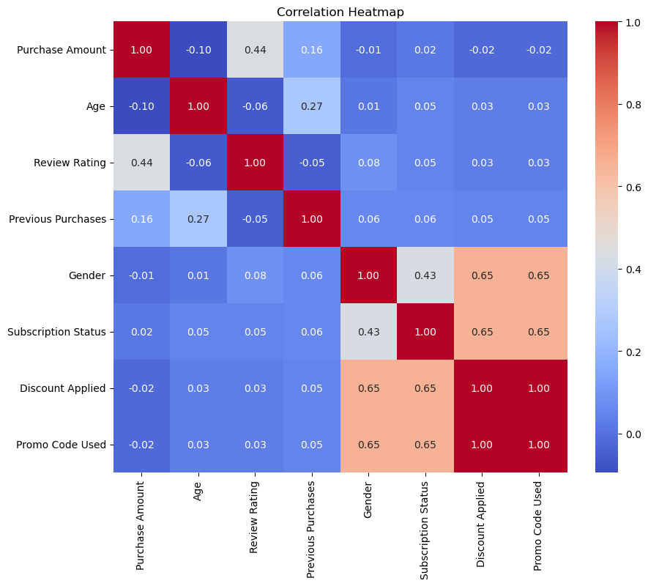
Pearson Correlation Coefficient - Correlation Heatmap

Slide 7
Client Clustering Models
ISOMAP, TSNE, LEE → K-Means
Pearson’s Correlation
Mars is actually a cold place. It’s a planet full of iron oxide dust
It’s the smallest and closest planet to the Sun in the Solar System

Slide 8
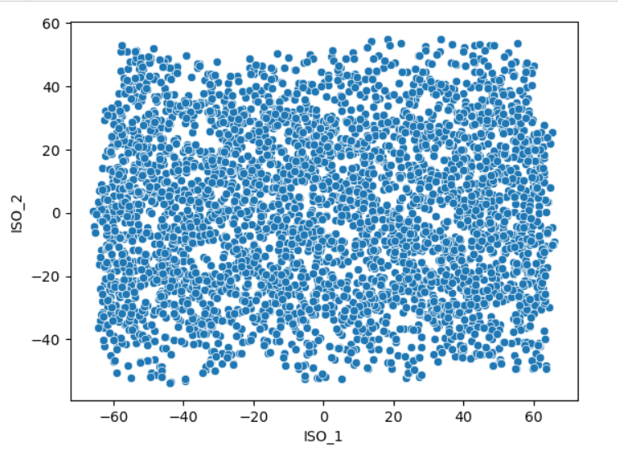
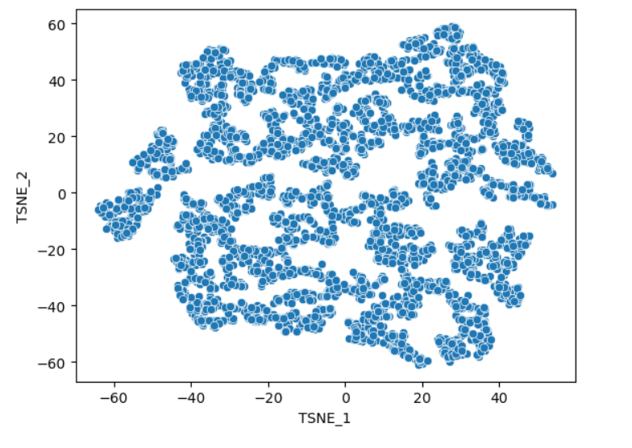
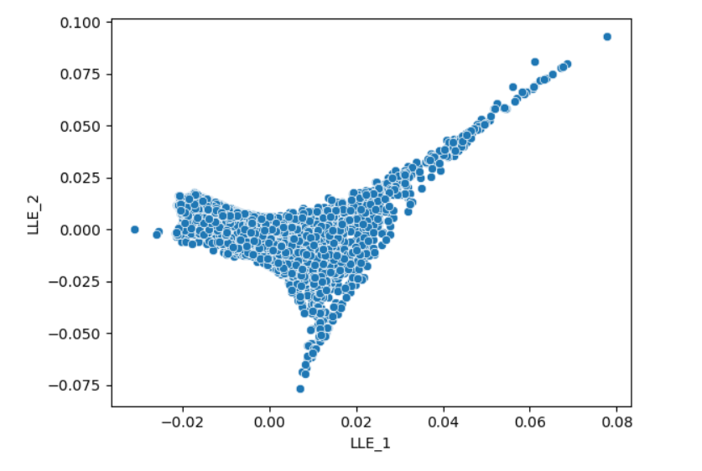
Applied Clustering Models
ISOMAP TSNE LLE

Slide 9
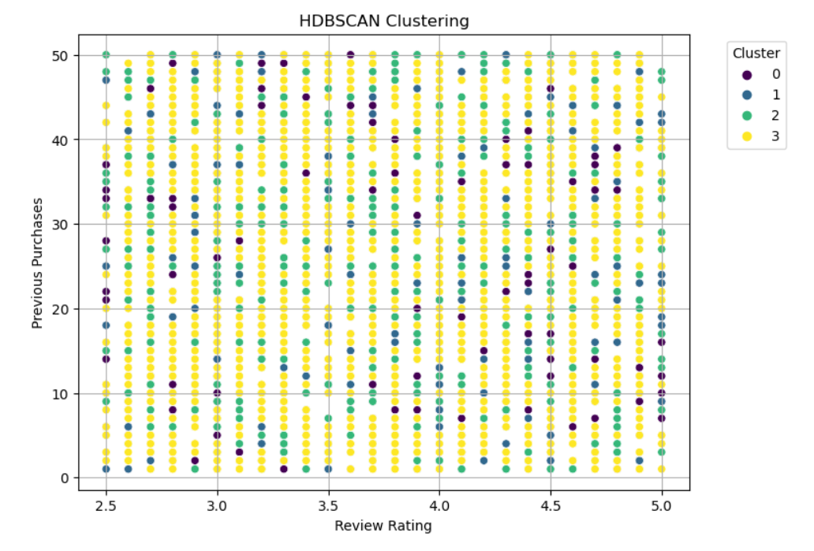
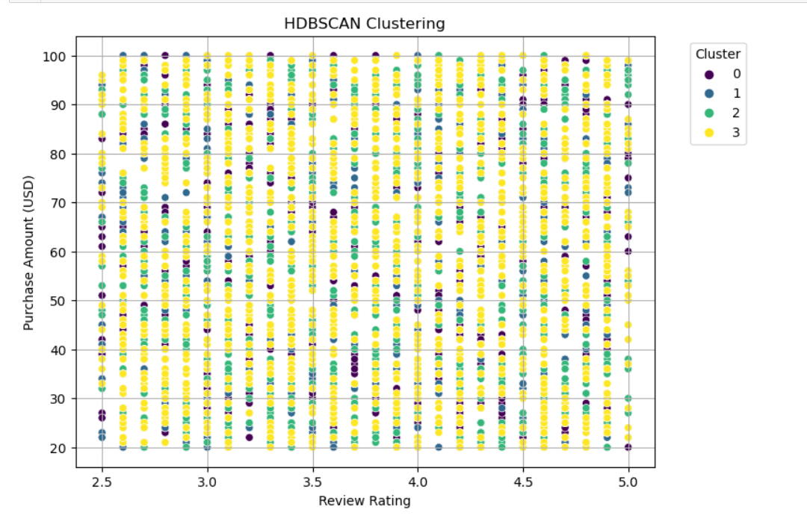
Applied Clustering Models
HDBSCAN

Slide 10
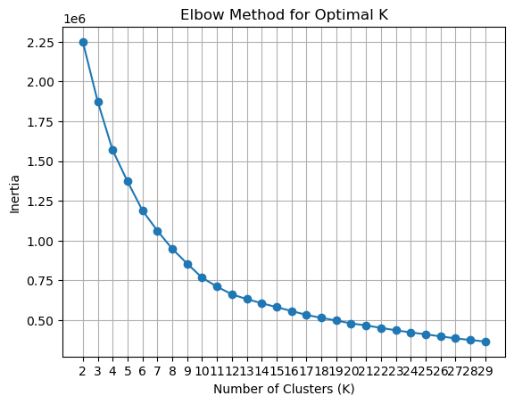
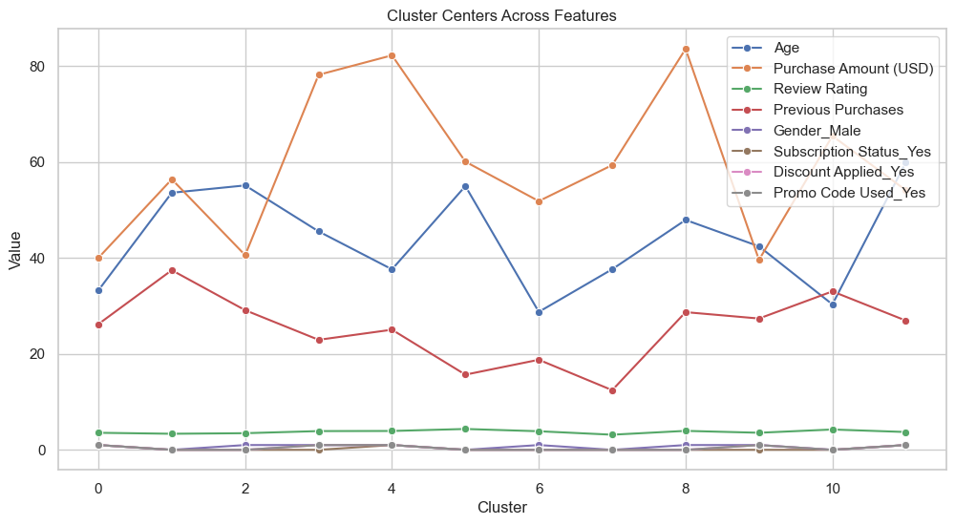
K-Means Clustering

Slide 11
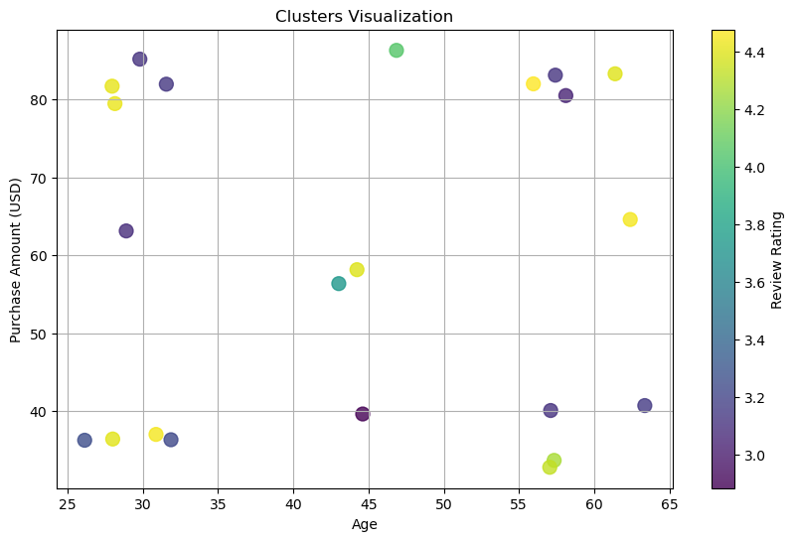
K-means Clusters

Slide 12
Customer Clusters by Gender
Age Groups : 30.3, 37.6, 55
Men
Age Groups : 28.7, 37.6, 55
Purchase Amount : 65.4$, 59.3$, 60$
Purchase Amount : 51.8, 82, 40
Review Ratings : 4.2, 3.1, 4.3
Review Ratings : 3.8 3.9, 3.4 ,
Previous Purchases : 33, 12, 15
Previous Purchases : 18.7, 12, 29
Women

Slide 13
Cluster Insights
Younger women tend to rate higher as they buy more from our products, although older women tend to rate high in general..
Purchase amount averages don’t fluctuate among women.
Main target groups among women are in their 30s and 50s.
Younger male audience tend to shop less, spend either higher from the average or low and give lower ratings in different cases.
Older male groups tend to buy more than average and rate higher.
Male subscribers are higher in number and show more fluctuating outcomes.

Slide 14
Conclusion
Customer segmentation models can be used to identify client clusters to see their online purchasing behaviours.
With an in-depth analysis of the “potential” targeting audience, we can build a better online marketing strategy.
More efficient customer targeting will result in better utilization of the budget and more efficiency.

Slide 15
Thank you!

